Slide 1




Semi-Autonomous Quadrotor Flight Simulation

Slide 2
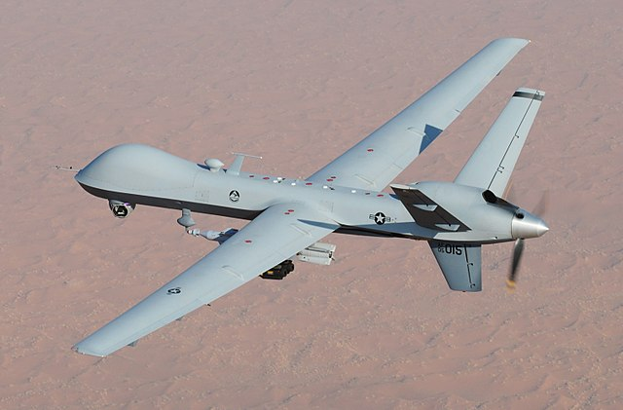
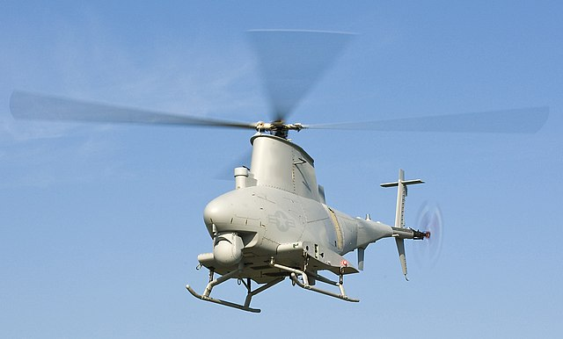
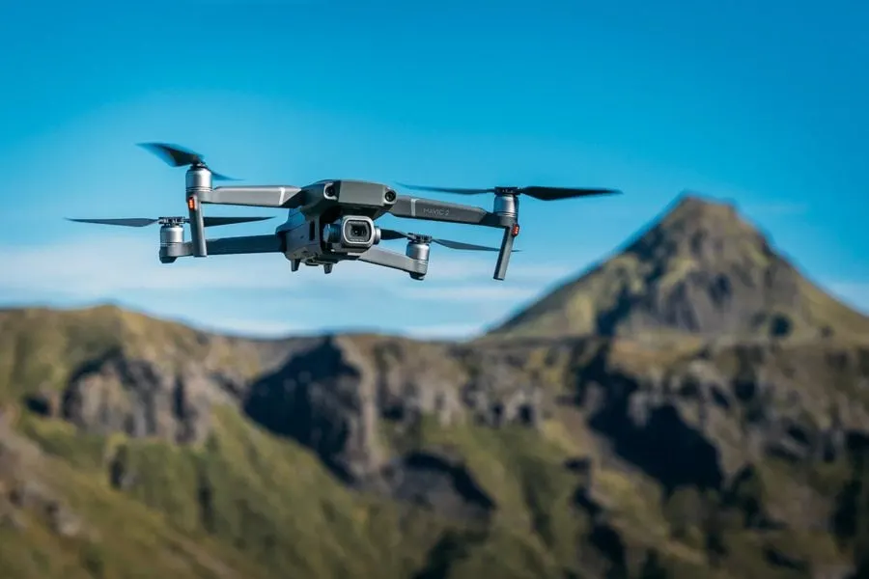
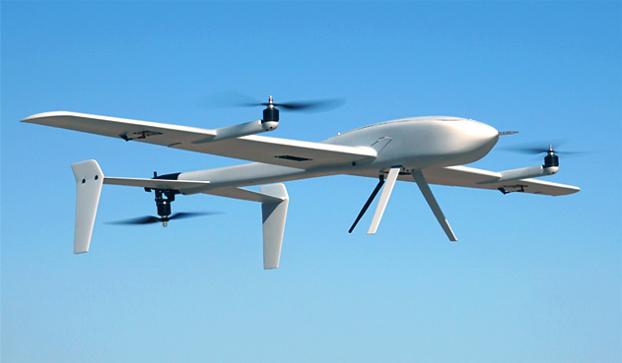
Introduction
Unmanned Aerial Vehicles (UAVs) a.k.a. Drones
Fixed-wing
Single-rotor
Multi-rotor
Fixed-Wing Hybrid VTOL
General Atomics MQ-9 Reaper (Courtesy: Wikipedia)
Northrop Grumman MQ-8 Fire Scout
(Courtesy: Wikipedia)
DJI Mavic 2
(Courtesy: DJI)
HammerHead Uav
(Courtesy: www.technosysind.com)
* Multi-rotor drones are the easiest and cheapest to make.

Slide 3
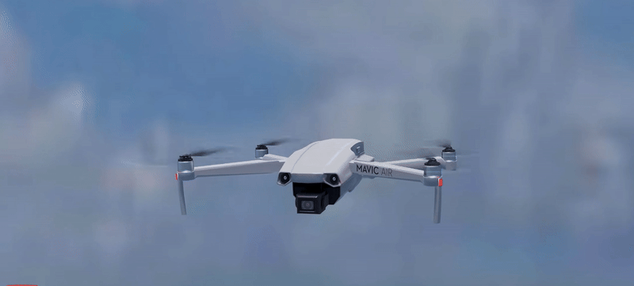
Introduction
Quadrotors / Quadcopters
Courtesy: sabinmathew.com

Slide 4

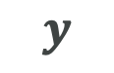









Introduction
$$Z_{b}$$
$$Z$$
Body frame
Inertial reference frame
$$z$$
$$Y$$
$$X_{b}$$
$$y$$
$$Y_{b}$$
$$X$$
$$x$$
Position: ($x,y,z)$
Orientation: body frame is orientation

Slide 5
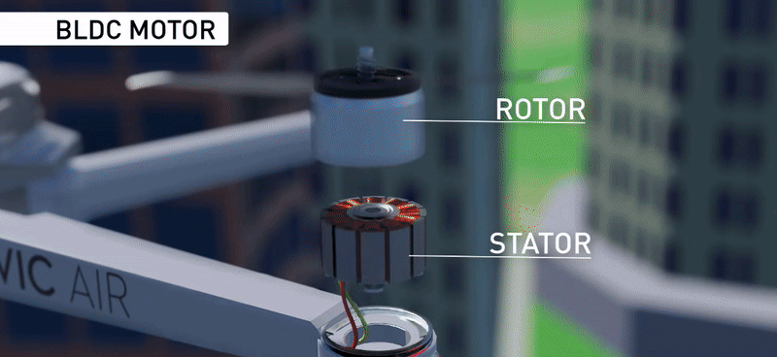
Introduction
Courtesy: sabinmathew.com

Slide 6
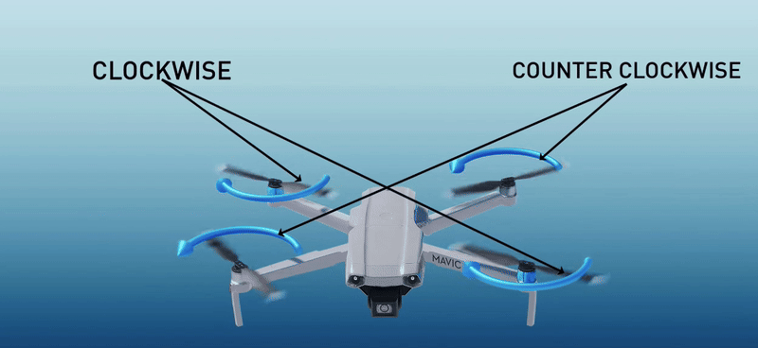
Introduction
Courtesy: sabinmathew.com

Slide 7
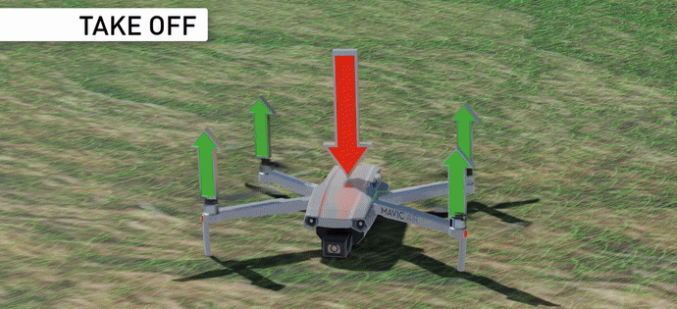
Introduction
Courtesy: sabinmathew.com

Slide 8
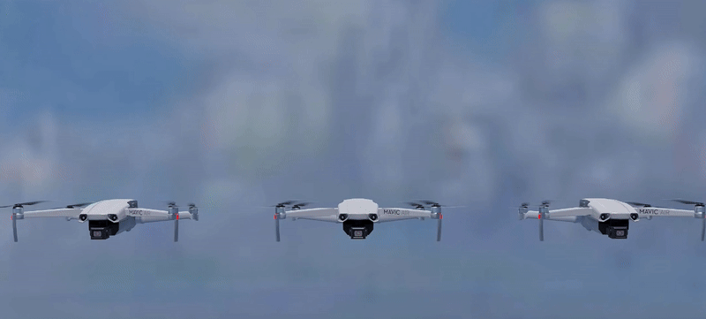
Introduction
How do quadrotors maneuver ?
Courtesy: sabinmathew.com

Slide 9
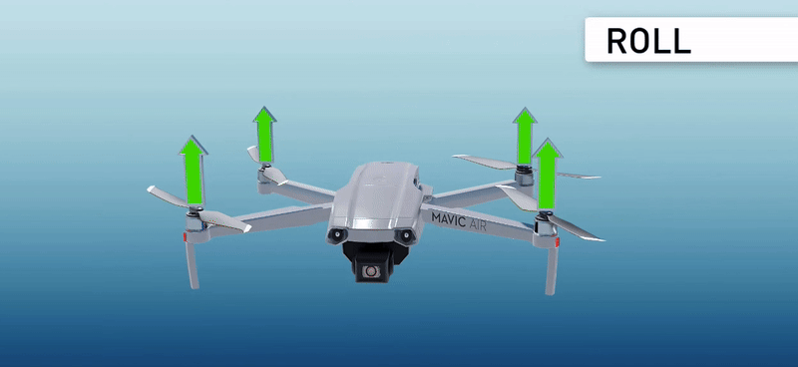
Introduction
Courtesy: sabinmathew.com

Slide 10
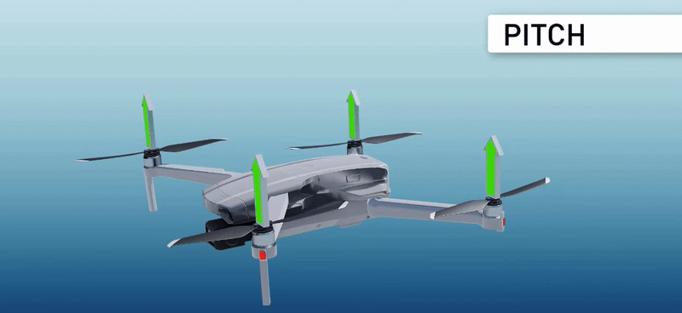
Introduction
Courtesy: sabinmathew.com
Cheon, J.H., Han, K., Hong, S.M., Kim, H.J., Kim, J., Kim, S., Seo, H., Shim, H. and Song, Y., 2018. Toward a secure drone system: Flying with real-time homomorphic authenticated encryption. IEEE access, 6, pp.24325-24339.

Slide 11
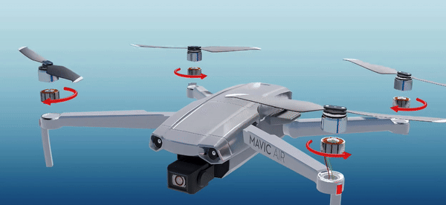
Introduction
Courtesy: sabinmathew.com

Slide 12
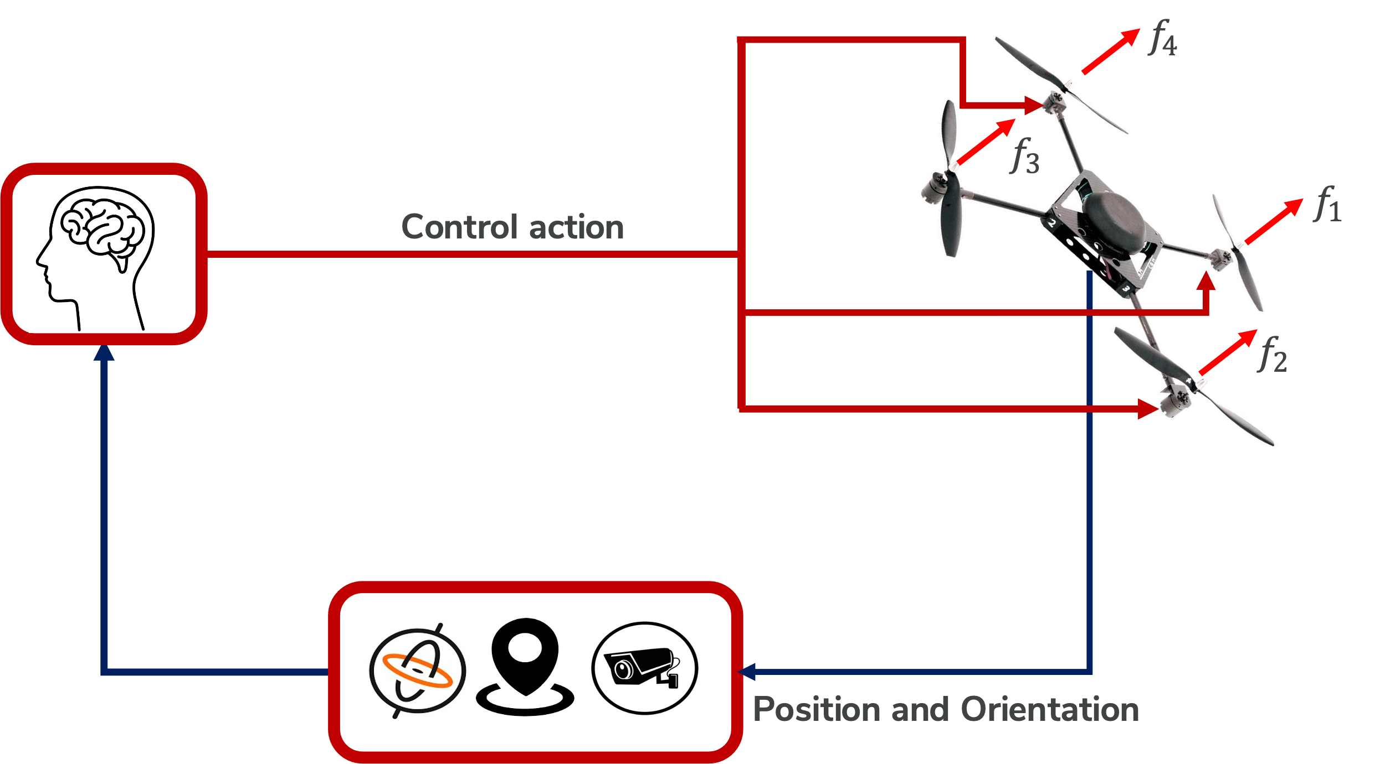


Quadrotor Semi-Autonomous Flight
Command
Position & Orientation
Mission

Slide 13





Quadrotor Semi-Autonomous Flight

Slide 14
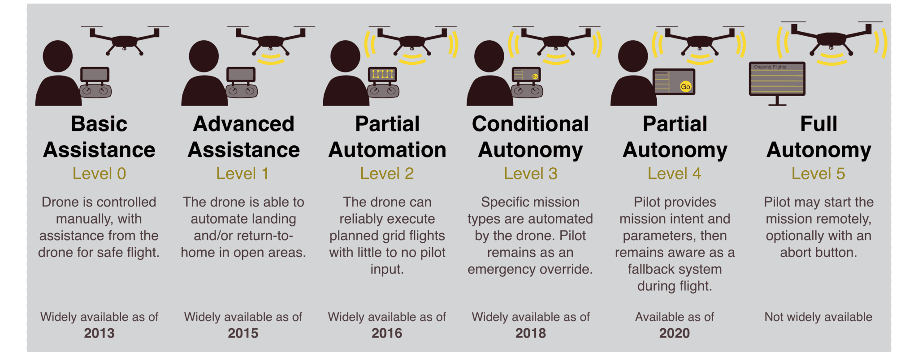
Quadrotor Semi-Autonomous Flight
Courtesy: droneanalyst.com

Slide 15
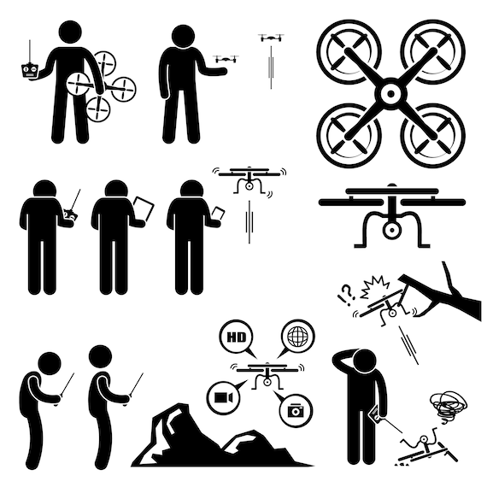


Computer Simulation
Computer simulation is like virtual reality, allowing us to test how the quadrotor would fly in different conditions using a computer program instead of a real drone.
Why Use Simulation?
Cost-effective
Convenient
Safe

Slide 16

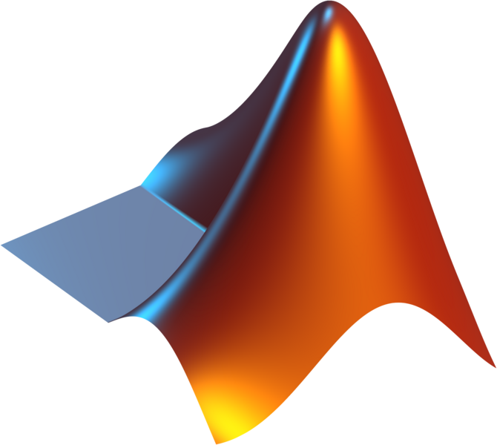
Computer Simulation
Ideate a model
Formulate mathematical equations (ODEs)
Implement the model in Software
Implement the brain
Visualize

Slide 17
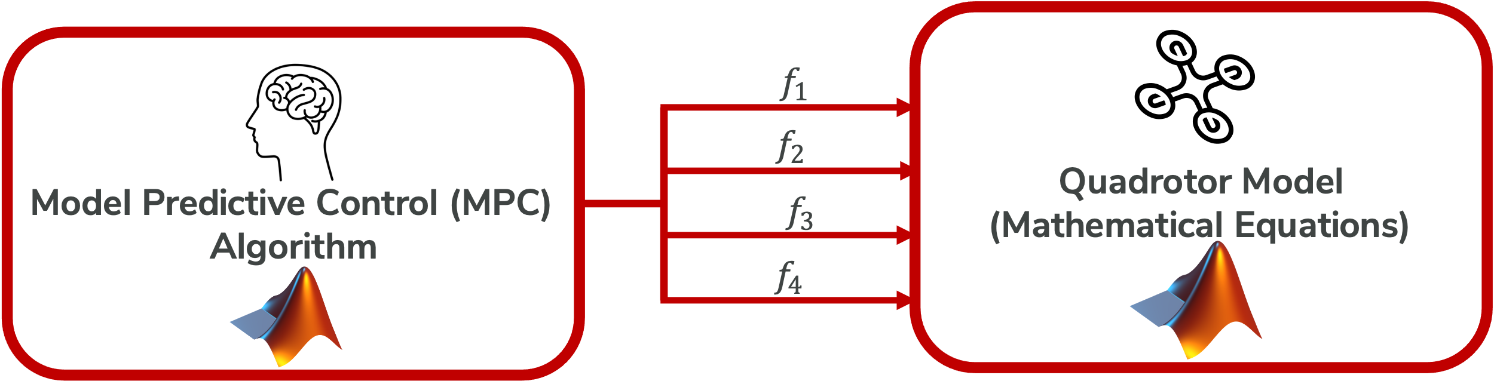

Computer Simulation
Desired Position & Orientation
Position & Orientation

Slide 18




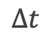

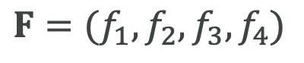


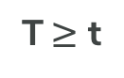

Model Predictive Control (MPC)
T sec
$$F=(f_{1},f_{2},f_{3},f_{4})$$
$$Δt$$
Command Trajectory
T$≥$ t
Position
&
Orientation
t sec
$$F^{∗}$$
$$F$$
$$F$$
$$F$$
Predicted Trajectories
$$F$$

Slide 19
Activity 1

Slide 20
Activity 2

Slide 21
Activity 3

Slide 22

Thank You !

